Slide 1
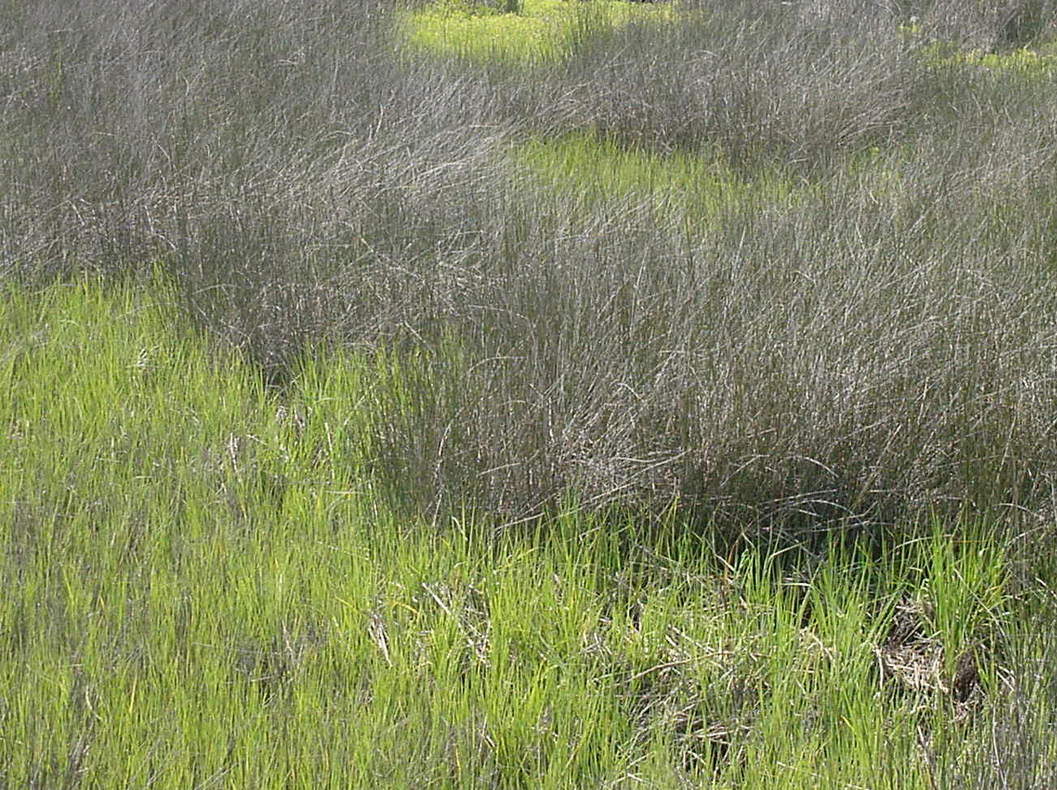
Salt Marshes -biotic perspectives
Maia McGuire, PhD
Florida Sea Grant Extension Agent

Slide 2
What is a salt marsh?
“A community of emerged halophytic vegetation in areas alternately inundated and drained by tidal action.”
“Expansive inter- or supratidal areas occupied by rooted emergent vascular macrophytes and a variety of epiphytes and epifauna.”
Emerged: sticking out of the water; Halophytic: salt-loving; Inundated: flooded; macrophyte: plant that’s large enough to see; epiphyte: plant growing on another organism but not a parasite; epifauna: animal version of epiphyte

Slide 3
Where are salt marshes found?
Along intertidal shore of estuaries
Flat, protected waters
Extensive from Maine-Florida, along Gulf coast from Florida-Texas
In FL, most abundant north of the freeze line (70% of state’s salt marsh)

Slide 4
The salt marsh community
Plants
Marsh grasses
Associated halophytic (salt-tolerant) plants
Animals
Permanent residents
Visitors

Slide 5
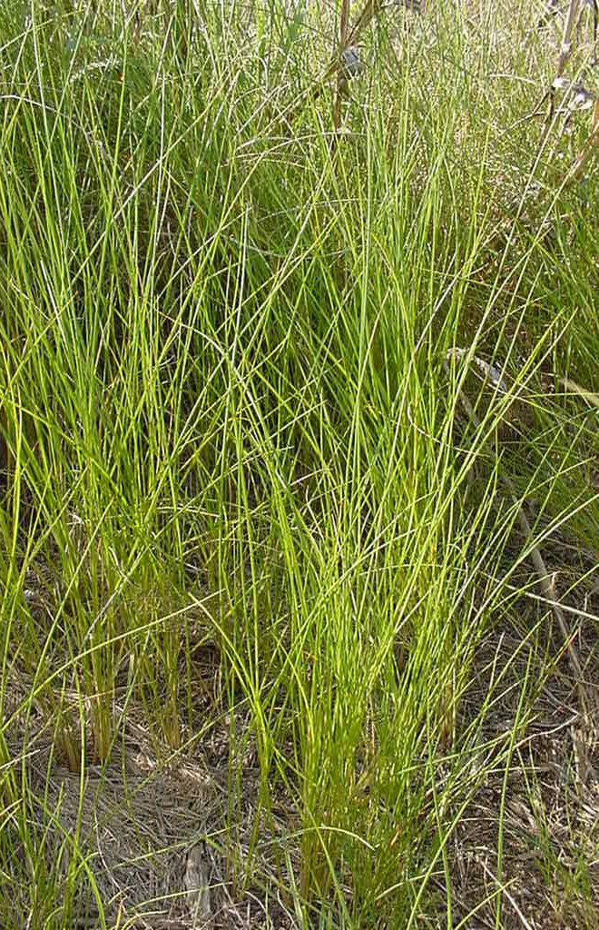
Salt marsh grasses
Spartina alterniflora
Smooth cord grass
Juncus roemerianus
Black needle rush
Cladium mariscoides
Swamp sawgrass
Spartina patens
Salt meadow cord grass

Slide 6
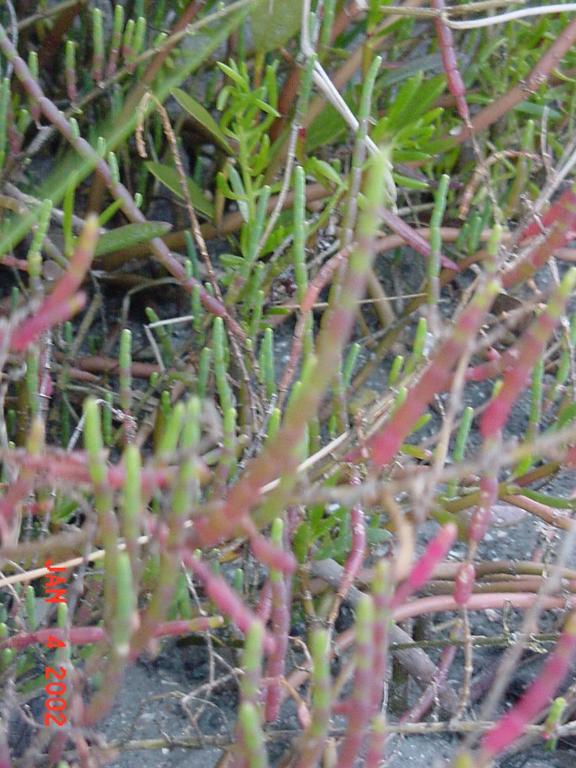
Associated plants
Many are succulent
Exceptions include saltgrass
Many are edible (saltwort, glasswort, sea purslane)
Form transitional zone between salt marsh and maritime hammock

Slide 7
Salt marsh zonation
Intertidal—Spartina, Juncus
High marsh (above mean high water)—Distichlis spicata, Batis maritima, Salicornia spp., Borrichia sp., Sueda linearis, Limonium carolinanum
Upper edge of high marsh—Iva frutescens, Baccharis halmifolia
Marsh-mangrove transition zone

Slide 8
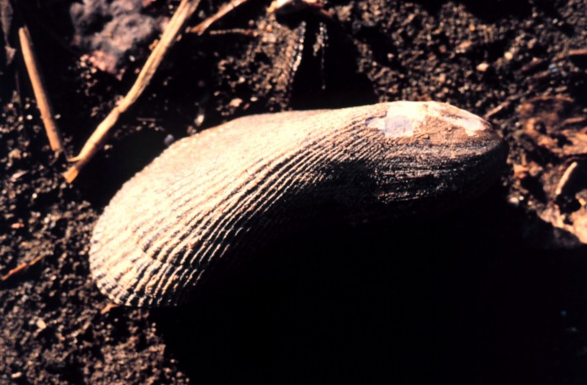
Resident animals
Littorina irrorata
Marsh periwinkle (snail)
Crabs
Fiddler crabs (Uca spp.)
Marsh crabs (Sesarma spp.)
Geukensia demissa
Ribbed mussel

Slide 9
Tidal Marsh Visitors
Birds
Crabs
Shrimp
Fish
Diamondback terrapin

Slide 10
The majority of commercially-important marine species rely on estuaries/salt marsh at some stage of life
Examples include blue crab, oysters, hard clams, shrimp, red drum, seatrout, sheepshead, bluefish, mullet

Slide 11
Importance of salt marshes
Productivity
Habitat
Erosion control
Filtration

Slide 12
Productivity
Biological term—amount of carbon produced per m² per unit time
3 kg (ash free dry weight)/m²/year
Limiting factors include nutrients, light
Salt marsh plants provide detritus for the estuarine food web
Few grazers on blades (< 10% of biomass)
Large detrital biomass supports broad food web

Slide 13
Partial salt marsh food web
Dolphins
Humans
Fish
Birds
Insects
Oysters
Mussels
Shrimp
Crabs
Snails
Marsh grass
Zooplankton
Bacteria, fungi
Detritus
Phytoplankton

Slide 14
Habitat
Nursery grounds
Feeding grounds
Microhabitats
Aerial
Benthic
Aquatic
Stressful environment
Rapid changes in temperature, salinity, water depth, dissolved oxygen
Sedimentation

Slide 15
This powerpoint was kindly donated to www.worldofteaching.com
http://www.worldofteaching.com is home to over a thousand powerpoints submitted by teachers. This is a completely free site and requires no registration. Please visit and I hope it will help in your teaching.

